Slide 1



An Order Management System Realized With Progressive Web Apps(PWA)
HOCHSCHULE FÜR TECHNIK UND WIRTSCHAFT DRESDEN (FH) Fakultät Informatik/Mathematik
ZHEJIANG UNIVERSITY OF SCIENCE AND TECHNOLOGY(ZUST)
Information and Computing Science
Wang Can & Luo Runyi

Slide 2
CONTENTS
01
02
03
System Analysis
Something Already Realized
Thesis Topic

Slide 3
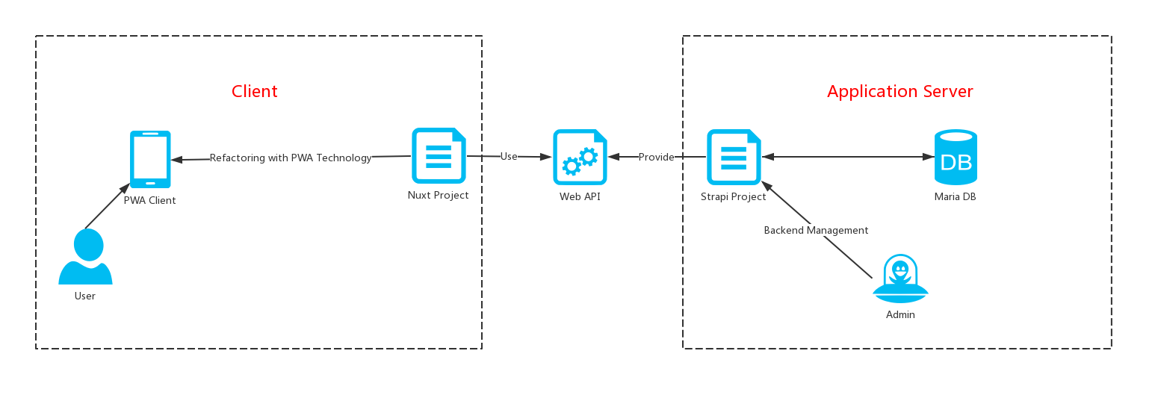
01
System Analysis
System Architecture
Figure 1 – The Structure Of The System

Slide 4
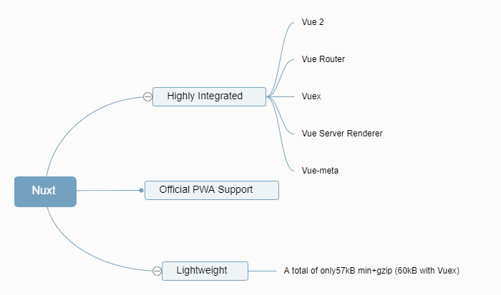
01
System Analysis
What is Nuxt.js?
Why is Nuxt.js?
Nuxt.js is a higher-level framework that builds on top of Vue.
It simplifies the development of universal or single page Vue apps.
Nuxt.js abstracts away the details of server and client code distribution
Figure 2 – The Advantages Of Nuxt.js

Slide 5
01
System Analysis
This chart shows what happens when we start a Nuxt program
and before the vue program starts.
NuxtServerInit is a VueX action method.
In essence, a middleware is a predefined function.
Like checking login status, validating user-submitted data, etc.
It gives validate access to data stored in URL and VueX.
AsyncData is called before Vue rendering, therefore, it has NOT this.
When navigate the page, it will go back to the lifecycle — “middleware”.
Figure 3 – Nuxt.js Schema

Slide 6
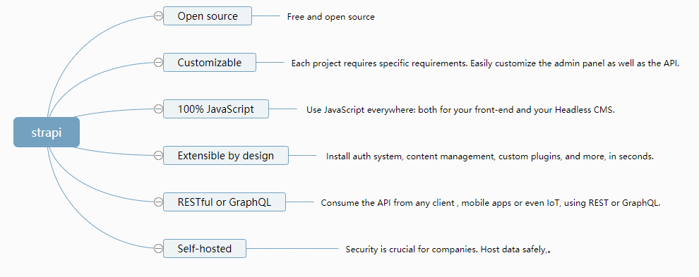
01
System Analysis
What is Strapi?
Strapi - Open source Node.js Headless CMS
Why is Strapi?
Figure 4 – The Advantages Of Strapi

Slide 7
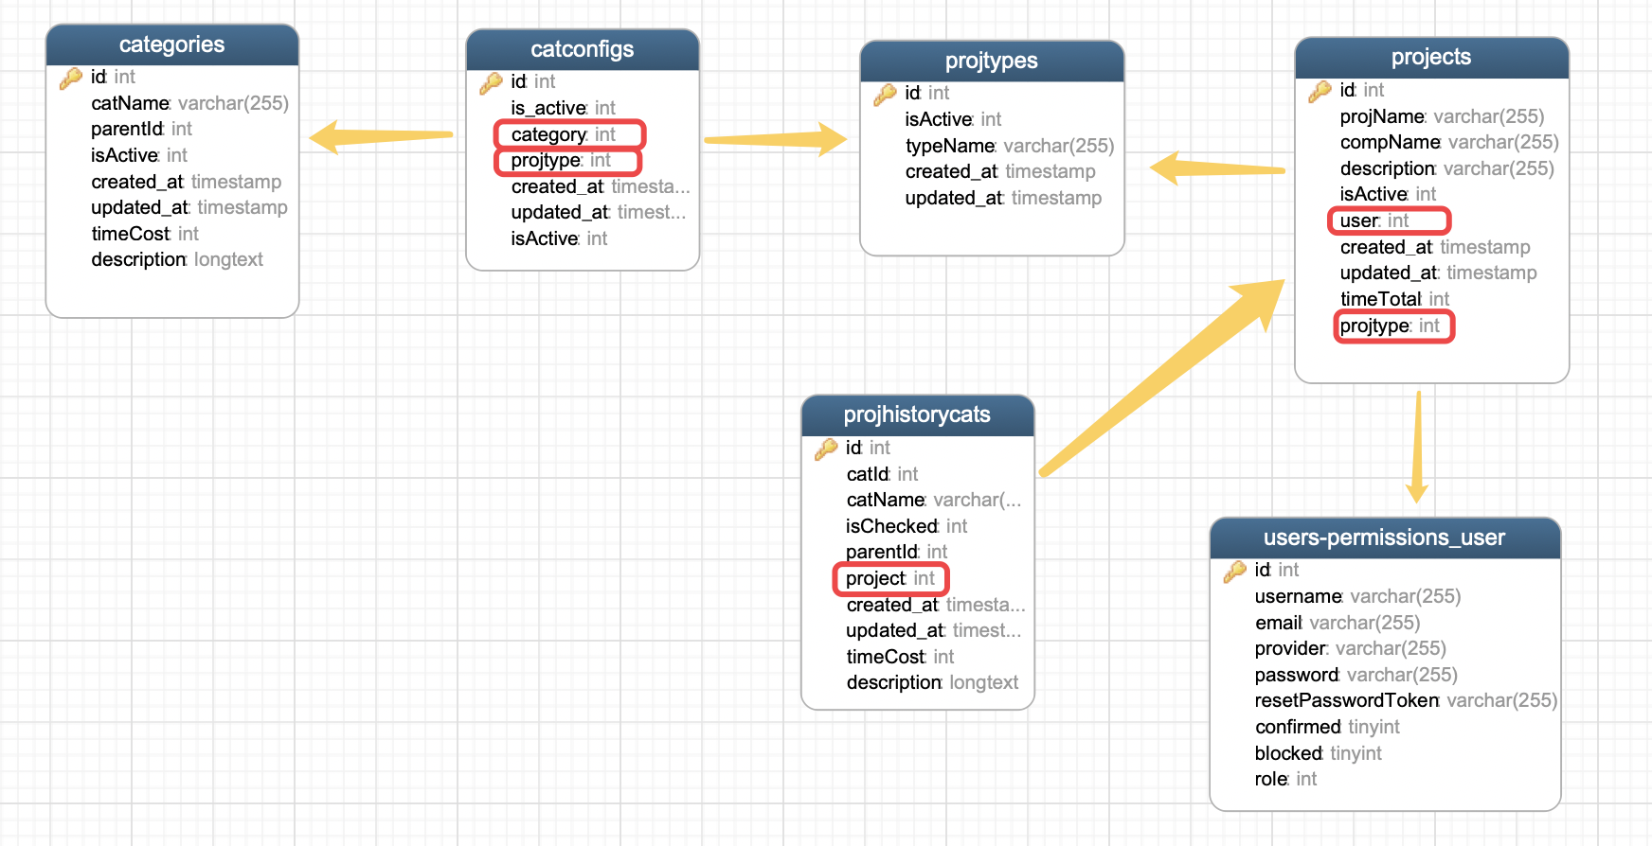
01
System Analysis
Database Design
Figure 5 – The Connection Between The Tables

Slide 8

02
Something Already Realized
All the static pages & Page logic
The main functions
Create a new project
Search projects
Auth external Api (JWT)
YOM

Slide 9
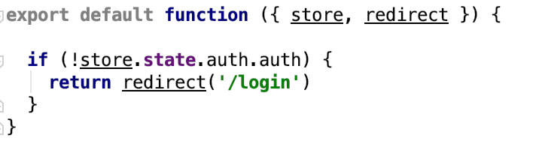
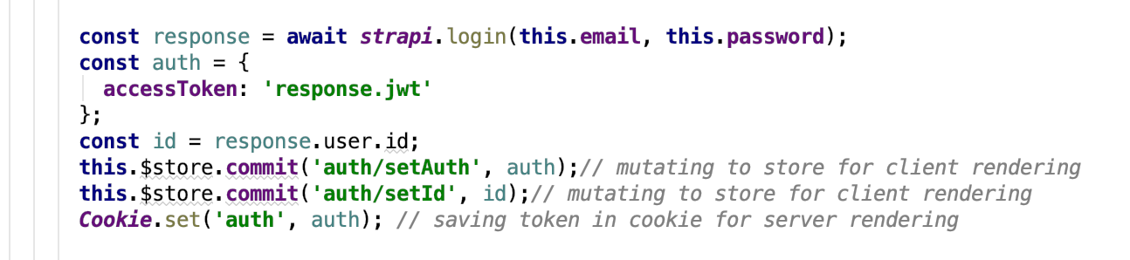
02
Something Already Realized
Auth Route(Using JWT & Middleware)
Strapi provides a useful user API.
The login api return Userinfo & JWT(JSON Web Token) for auth.
Figure 6 – middleware/authenticated.js
Figure 7 – pages/login.vue

Slide 10
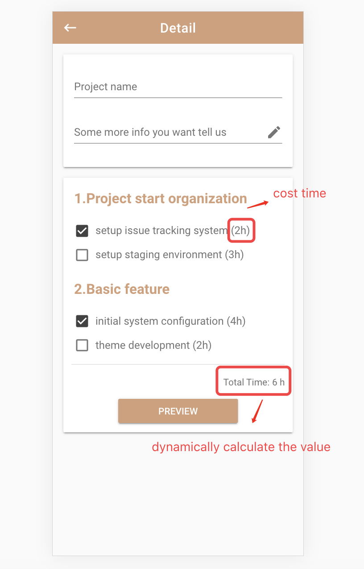
02
Something Already Realized
Detail Page
When you check the item, the value of “Total Time” will dynamically be calculated.

Slide 11
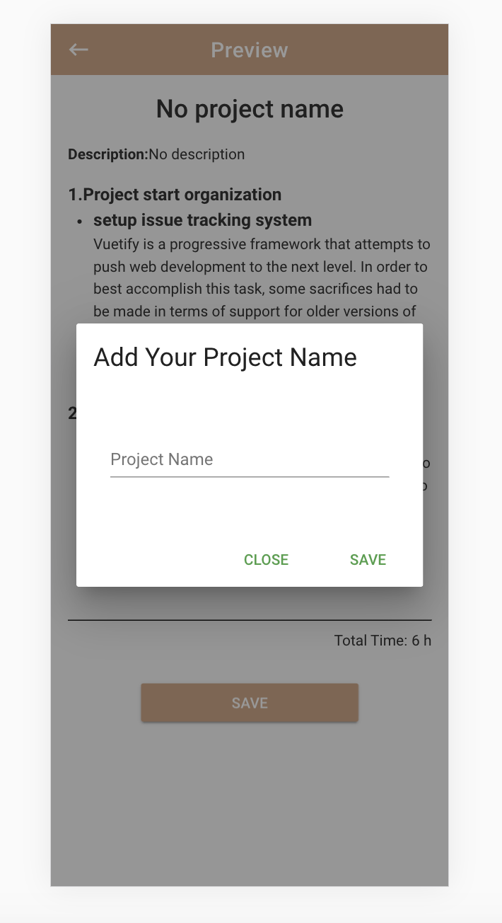
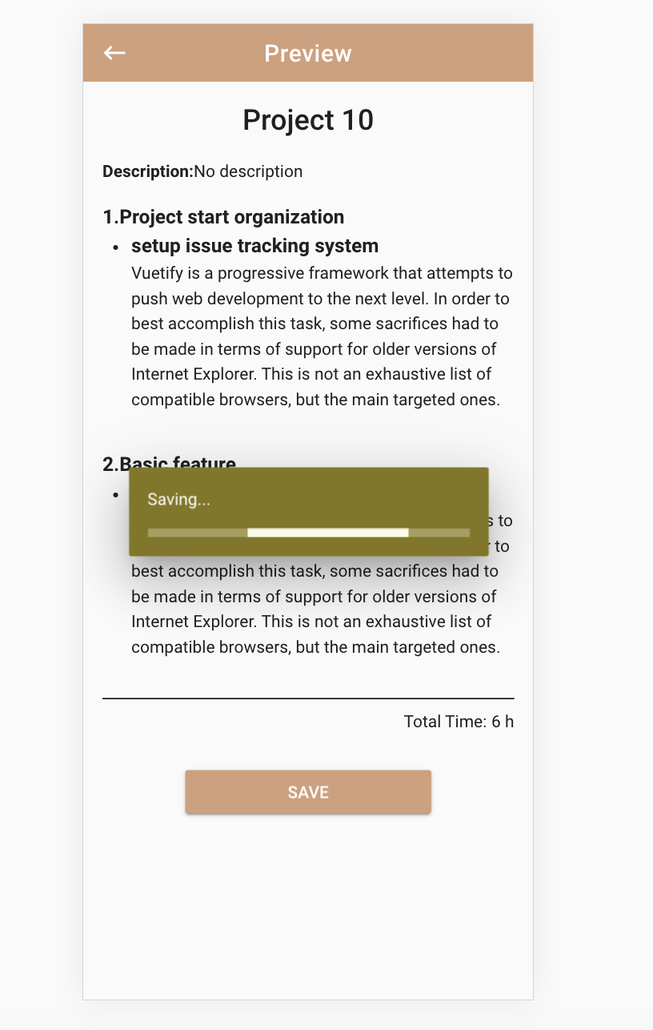
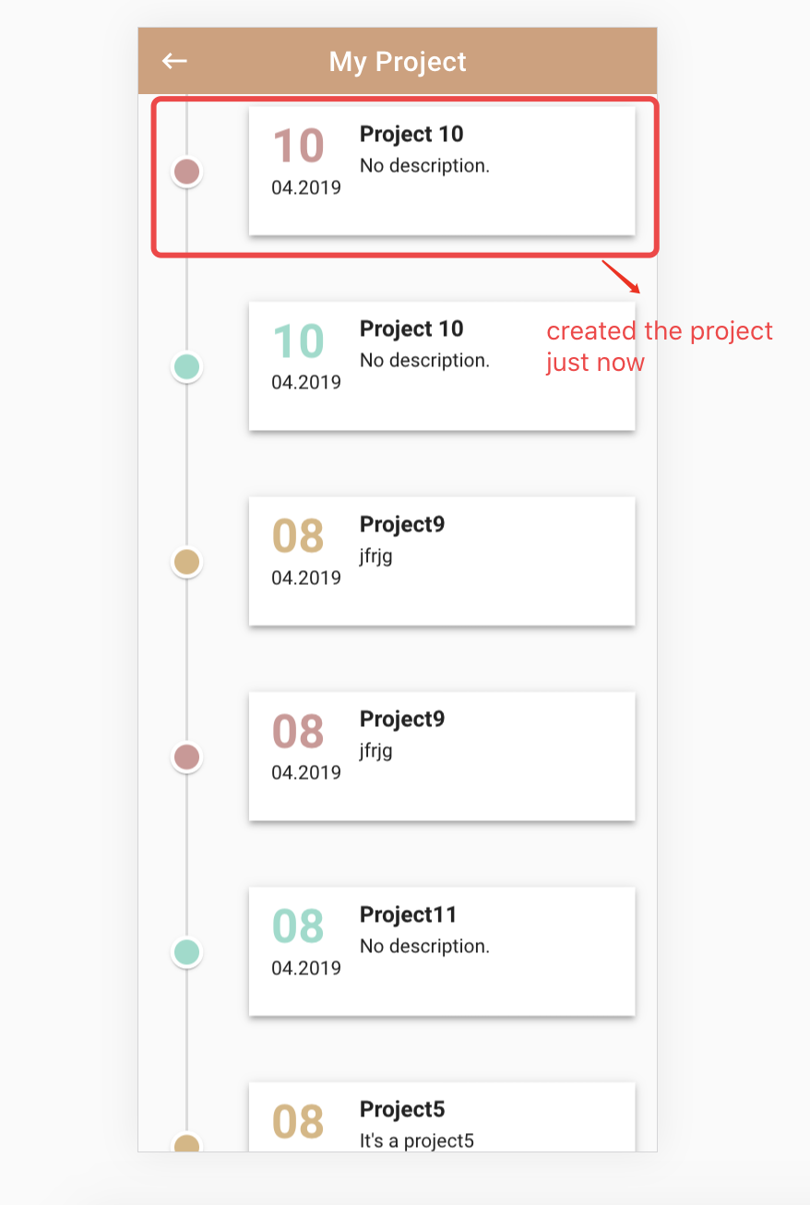
02
Something Already Realized
Preview Page
1. If user doesn’t add “project name” at the detail page, user has to add it while saving the project.
2. Click “save” => The dialog “Add Your Project Name” shows => Save data successfully => Go to “project page”.
3. User also can go back to “Detail Page” to add the project name or edit the checked items.

Slide 12
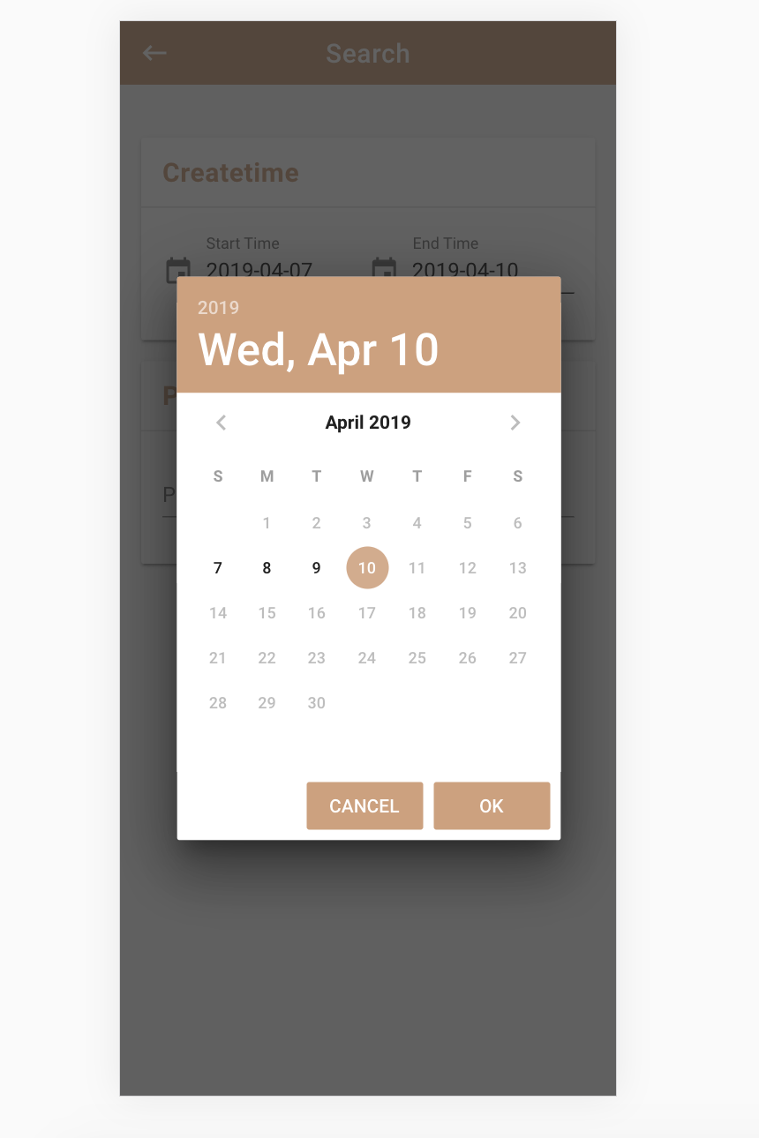
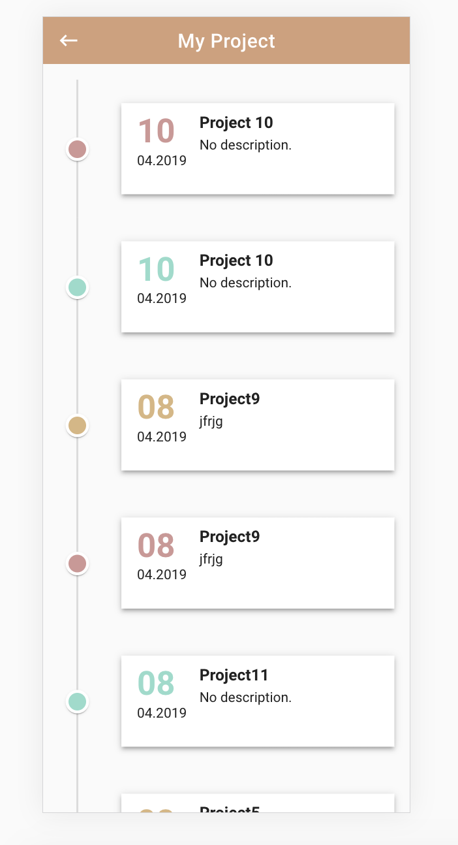
02
Something Already Realized
Search Page & Project Page
1. End time is between start time and the today’s date.
2. Click “SEARCH” => “Project Page” shows the first 10 datas => Pull down the page => Another 10 datas loaded

Slide 13
03
THESIS TOPIC
A nuxt&strapi infrastructure for order management system for a PWA client(Wang Can)
A nuxt-pwa client for order management system with offline capability(Luo Runyi)

